Slide 1
LISTS and TUPLES

Slide 2
Topics
Sequences
Introduction to Lists
List Slicing
Finding Items in Lists with the in Operator
List Methods and Useful Built-in Functions

Slide 3

Topics (cont’d.)
Copying Lists
Processing Lists
Two-Dimensional Lists
Tuples

Slide 4
Sequences
Sequence: an object that contains multiple items of data
  The items are stored in sequence one after another
Python provides different types of sequences, including lists and tuples
  The difference between these is that a list is mutable and a tuple is immutable

Slide 5
Introduction to Lists
List: an object that contains multiple data items
  Element: An item in a list
  Format: list = [item1, item2, etc.]
  Can hold items of different types
print function can be used to display an entire list
list() function can convert certain types of objects to lists

Slide 6
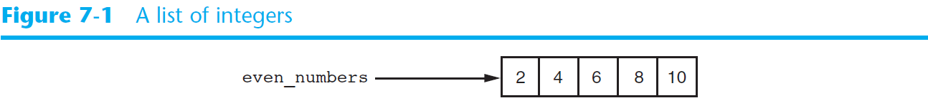


Introduction to Lists (cont’d.)

Slide 7
The Repetition Operator and Iterating over a List
Repetition operator: makes multiple copies of a list and joins them together
  The * symbol is a repetition operator when applied to a sequence and an integer
    Sequence is left operand, number is right
  General format: list * n
You can iterate over a list using a for loop
  Format: for x in list:

Slide 8
Indexing
Index: a number specifying the position of an element in a list
  Enables access to individual element in list
  Index of first element in the list is 0, second element is 1, and n’th element is n-1
  Negative indexes identify positions relative to the end of the list
    The index -1 identifies the last element, -2 identifies the next to last element, etc.

Slide 9
The len function
An IndexError exception is raised if an invalid index is used
len function: returns the length of a sequence such as a list
  Example: size = len(my_list)
  Returns the number of elements in the list, so the index of last element is len(list)-1
  Can be used to prevent an IndexError exception when iterating over a list with a loop

Slide 10
Lists Are Mutable
Mutable sequence: the items in the sequence can be changed
  Lists are mutable, and so their elements can be changed
An expression such as
list[1] = new_value can be used to assign a new value to a list element
  Must use a valid index to prevent raising of an IndexError exception

Slide 11
Concatenating Lists
Concatenate: join two things together
The + operator can be used to concatenate two lists
  Cannot concatenate a list with another data type, such as a number
The += augmented assignment operator can also be used to concatenate lists

Slide 12
List Slicing
Slice: a span of items that are taken from a sequence
  List slicing format: list[start : end]
  Span is a list containing copies of elements from start up to, but not including, end
    If start not specified, 0 is used for start index
    If end not specified, len(list) is used for end index
  Slicing expressions can include a step value and negative indexes relative to end of list

Slide 13
Finding Items in Lists with the in Operator
You can use the in operator to determine whether an item is contained in a list
  General format: item in list
  Returns True if the item is in the list, or False if it is not in the list
Similarly you can use the not in operator to determine whether an item is not in a list

Slide 14
List Methods and Useful Built-in Functions
append(item): used to add items to a list – item is appended to the end of the existing list
index(item): used to determine where an item is located in a list
  Returns the index of the first element in the list containing item
  Raises ValueError exception if item not in the list

Slide 15
List Methods and Useful Built-in Functions (cont’d.)
insert(index, item): used to insert item at position index in the list
sort(): used to sort the elements of the list in ascending order
remove(item): removes the first occurrence of item in the list
reverse(): reverses the order of the elements in the list

Slide 16
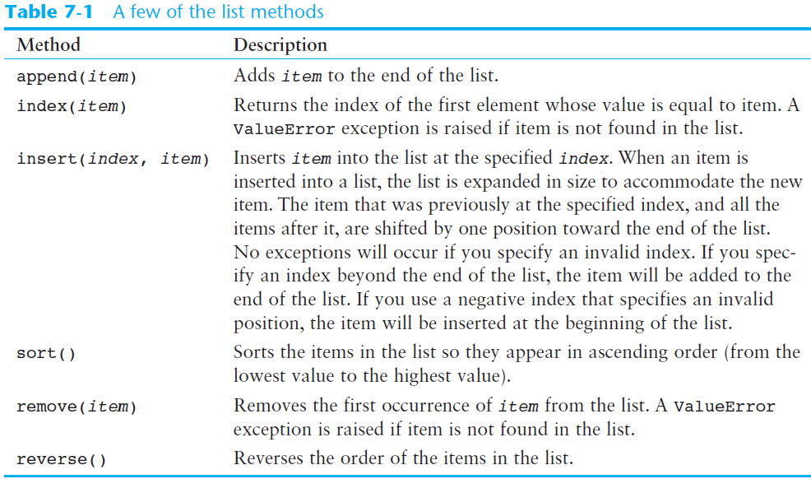

Slide 17
List Methods and Useful Built-in Functions (cont’d.)
del statement: removes an element from a specific index in a list
  General format: del list[i]
min and max functions: built-in functions that returns the item that has the lowest or highest value in a sequence
  The sequence is passed as an argument

Slide 18
Copying Lists
To make a copy of a list you must copy each element of the list
  Two methods to do this:
    Creating a new empty list and using a for loop to add a copy of each element from the original list to the new list
    Creating a new empty list and concatenating the old list to the new empty list

Slide 19
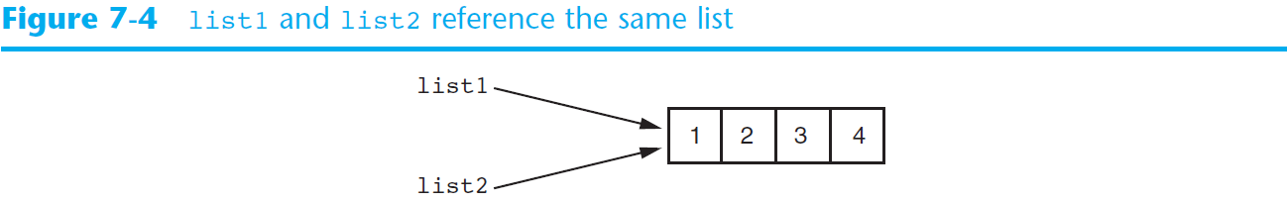
Copying Lists (cont’d.)

Slide 20
Processing Lists
List elements can be used in calculations
To calculate total of numeric values in a list use loop with accumulator variable
To average numeric values in a list:
  Calculate total of the values
  Divide total of the values by len(list)
List can be passed as an argument to a function

Slide 21
Processing Lists (cont’d.)
A function can return a reference to a list
To save the contents of a list to a file:
  Use the file object’s writelines method
    Does not automatically write \n at then end of each item
  Use a for loop to write each element and \n
To read data from a file use the file object’s readlines method

Slide 22
Two-Dimensional Lists
Two-dimensional list: a list that contains other lists as its elements
  Also known as nested list
  Common to think of two-dimensional lists as having rows and columns
  Useful for working with multiple sets of data
To process data in a two-dimensional list need to use two indexes
Typically use nested loops to process

Slide 23
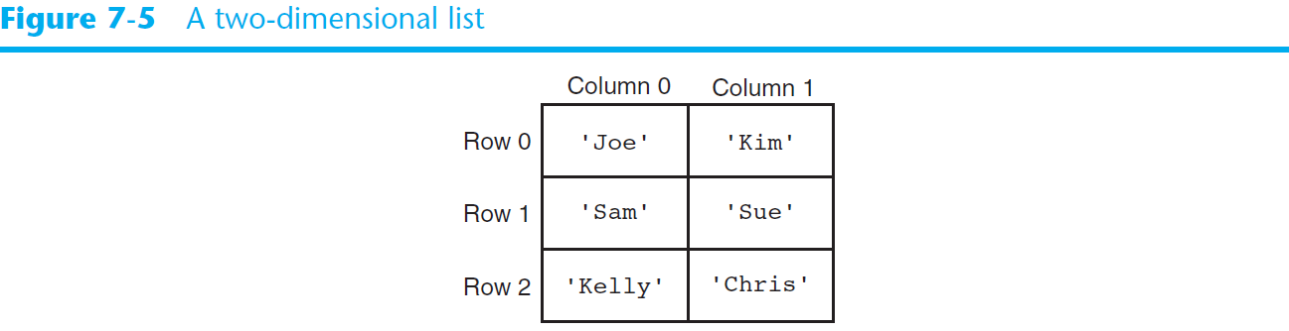
Two-Dimensional Lists (cont’d.)

Slide 24
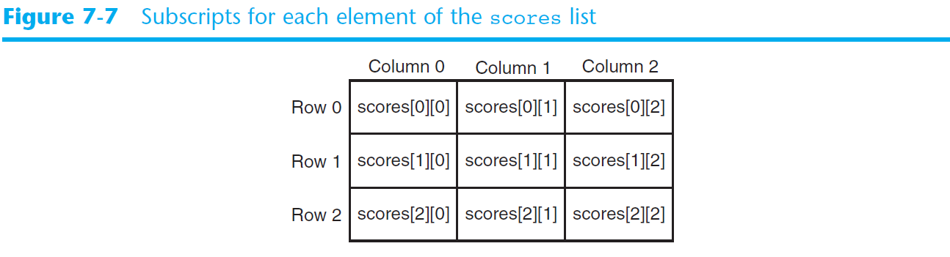
Two-Dimensional Lists (cont’d.)

Slide 25
Tuples
Tuple: an immutable sequence
  Very similar to a list
  Once it is created it cannot be changed
  Format: tuple_name = (item1, item2)
  Tuples support operations as lists
    Subscript indexing for retrieving elements
    Methods such as index
    Built in functions such as len, min, max
    Slicing expressions
    The in, +, and * operators

Slide 26
Tuples (cont’d.)
Tuples do not support the methods:
  append
  remove
  insert
  reverse
  sort

Slide 27
Tuples (cont’d.)
Advantages for using tuples over lists:
  Processing tuples is faster than processing lists
  Tuples are safe
  Some operations in Python require use of tuples
list() function: converts tuple to list
tuple() function: converts list to tuple

Slide 28
Summary
This chapter covered:
  Lists, including:
    Repetition and concatenation operators
    Indexing
    Techniques for processing lists
    Slicing and copying lists
    List methods and built-in functions for lists
    Two-dimensional lists
  Tuples, including:
    Immutability
    Difference from and advantages over lists

